Slide 1
Rules: 2-4 Teams Scribe: to record answers for each round Must be new scribe every five rounds Points: Each question correct (written on Fancy Sheets) gets 1 pt. Teams that answer correctly go to Bonus Round Quickest team correct (by holding sheet up) in Bonus Round gets the rock to shoot for Bonus pts 3 shots allowed at 1 pt each
Barratt b-ball trivia

Slide 2
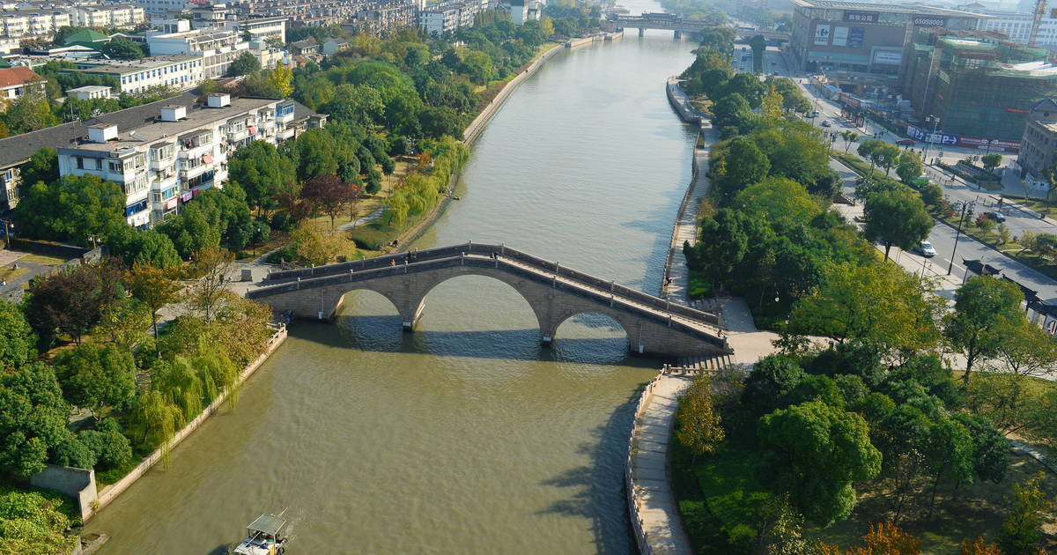
The Grand Canal (left) brought trade and visiting travelers to which city?
Round One
A. Timbuktu | Tenochtitlan
B. Chang’an | D. Delhi
Answer: B

Slide 3
Identify the holy prophet of Islam.
Bonus Round One
Answer: Muhammad

Slide 4
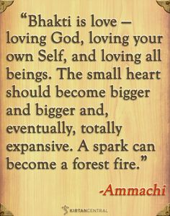
The quote (right) embodies a medieval era movement aimed at strengthening which religion?
Round two
Buddhism | Hinduism
Confucianism | D. Animism
Answer: C

Slide 5
What American society was known for establishing city-states?
Bonus Round two
Answer: mayans

Slide 6
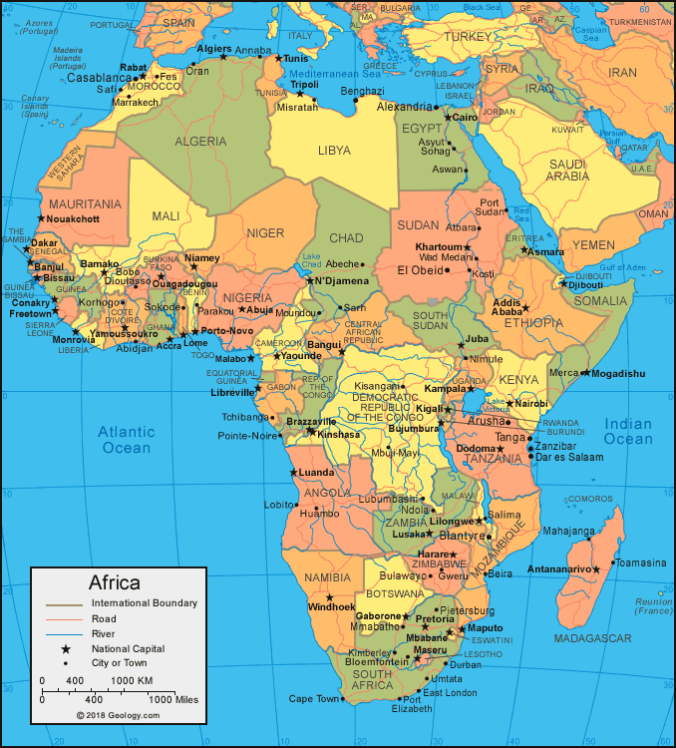
Which of the following does NOT represent a “great tradition” of societies from the region seen at right.
Round three
A. Bantu language | Kinship
B. Human sacrifice | D. Female lineage
Answer: B

Slide 7
These “holy wars” ended in defeat for many Christian knights in the 12th century.
Bonus Round three
Answer: crusades

Slide 8
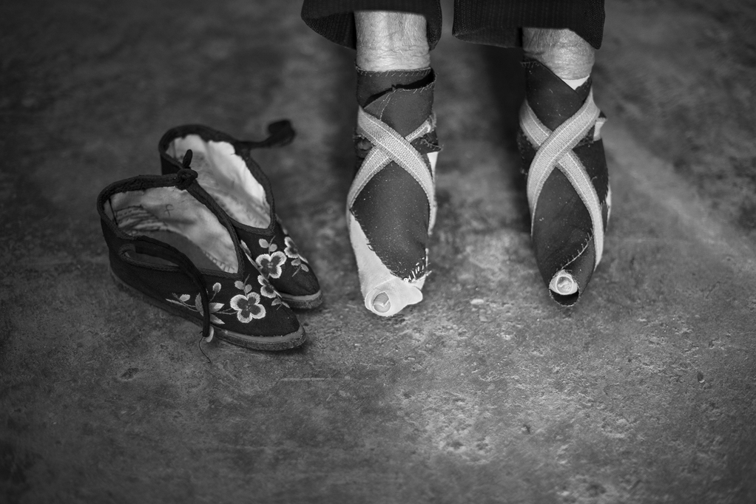
The tradition evident in the image (left) was most prevalent amongst elite women of which dynasty?
Round four
Qin Dynasty | Tang Dynasty
Han Dynasty | D. Song Dynasty
Answer: D

Slide 9
When the Muslims conquered this location in the 8th century, they would set in motion a ‘melting pot’ of Muslim, Jewish, and Christian cultures.
Bonus Round four
Answer: al-andalus (spain)

Slide 10
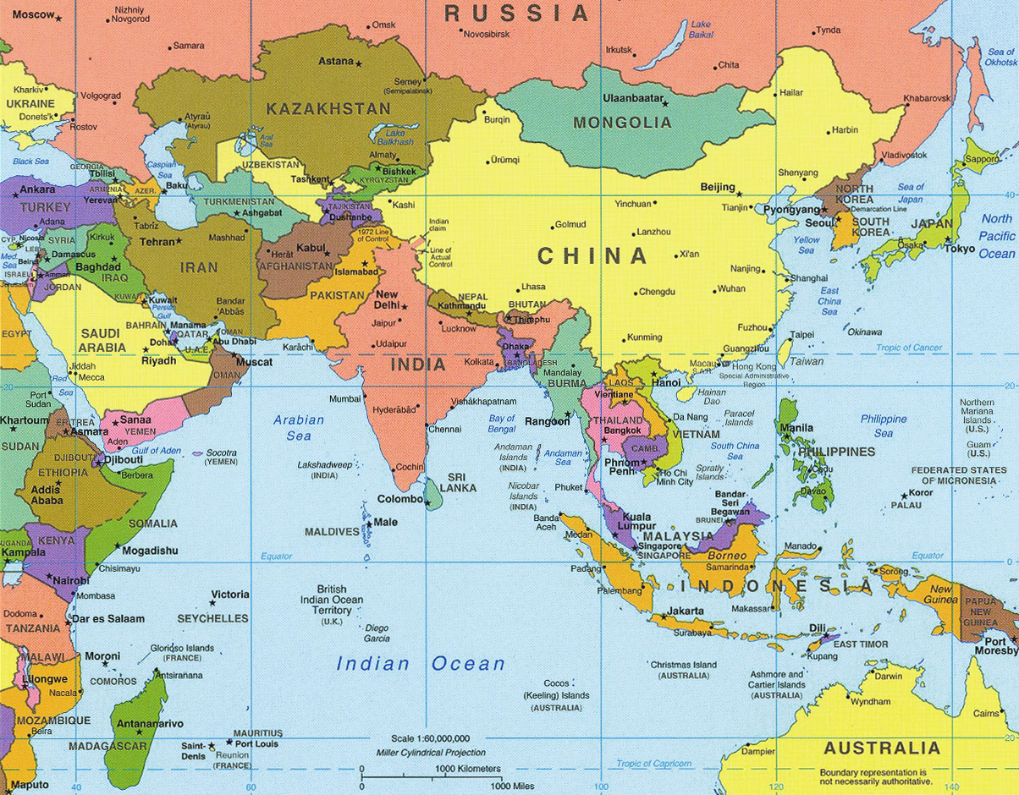
The Vijayanagar, Sinhalese, and Khmer Empires had which of the following in common?
Round five
Indian Ocean Trade Network | Spread of Christianity
Muslim sultans as rulers | D. Use of paper currency
Answer: A

Slide 11
Chaco Canyon and Mesa Verde are two urban sites of what desert-dwelling American tribal group?
Bonus Round five
Answer: pueblos

Slide 12
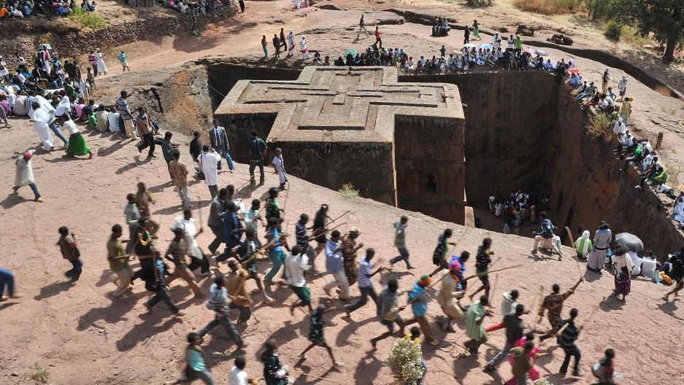
Christianity became the mainstay religion (since the 4th century) of which African nation?
Round six
Ethiopia | Zimbabwe
Hausa States | D. Ghana
Answer: A

Slide 13
Identify Europe’s “rebirth” in Greco-Roman studies attributed to humanism.
Bonus Round six
Answer: renaissance

Slide 14
Identify the philosophy embodied by the quote below.
Round seven
“A youth, when at home, should be filial and, abroad, respectful to his elders. He should be earnest and truthful. He should overflow in love to all and cultivate the friendship of the good. When he has time and opportunity, after the performance of these things, he should employ them in polite studies.”
Christianity | Confucianism
Legalism | Daoism
Answer: c

Slide 15
What holy city is shared by three religions?
Bonus Round seven
Answer: jerusalem

Slide 16
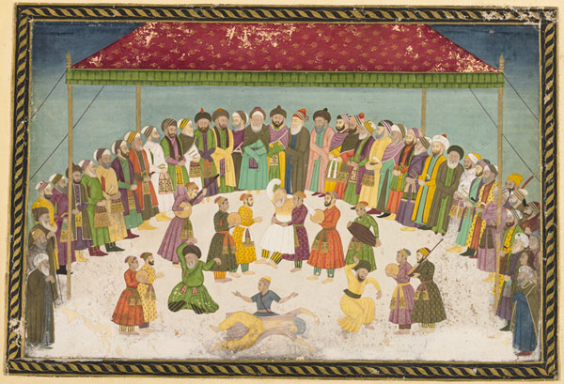
Which of the following represents a “fraternity” of Muslim youths who practiced missionary work?
Round eight
Bhakti Movement | Sufi Brotherhoods
Crusaders | D. Tibetan monks
Answer: c

Slide 17
Their empire encompassed diverse climates of South America, which they built elaborate roads to connect.
Bonus Round eight
Answer: incas

Slide 18
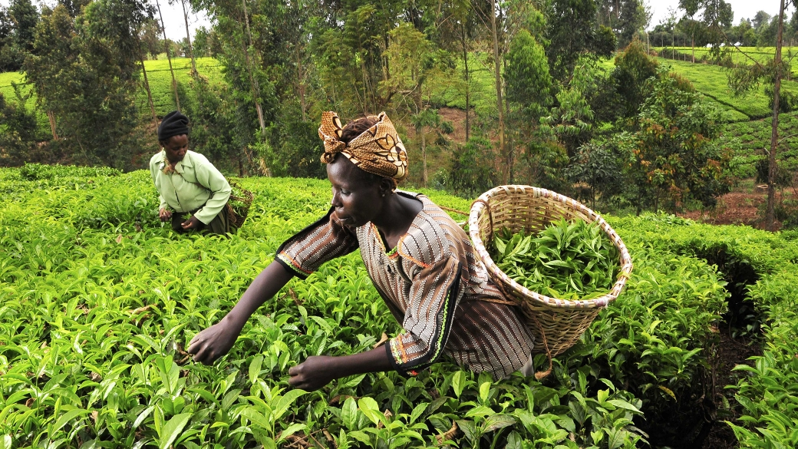
Which of the following never existed in sub-Saharan Africa prior to European contact?
Round nine
Slavery | Iron working
Language | Writing
Answer: d

Slide 19
Latin for the “Great Charter”, what document limited the power of English kings in 1215?
Bonus Round nine
Answer: magna carta

Slide 20
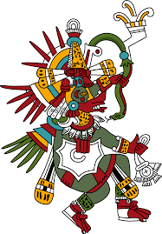
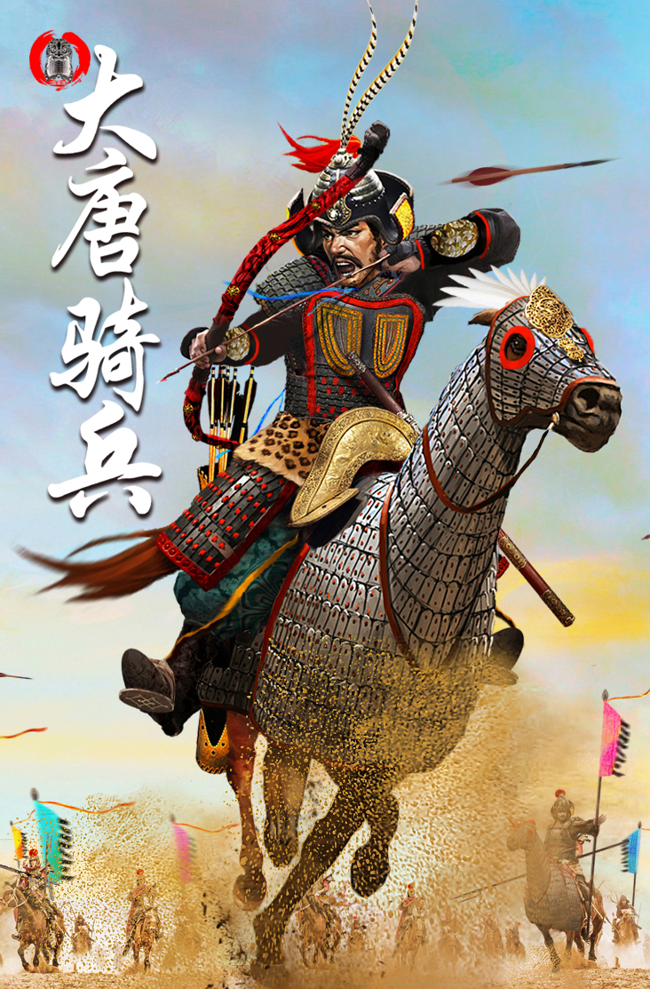
The Aztecs compare with Tang Dynasty China in that both were:
Round ten
trade partners. | tributary states.
into human sacrifice. | abundant with corn.
Answer: C

Slide 21
Abbasid caliphs allowed non-Muslim “People of the Book” to practice their faith if________.
Bonus Round ten
Answer: they paid a tax.

Slide 22
Rules: Option 1 (Sabotage) – Assassin gets 3 shots; each score removes 1 pt from selected team Option 2 (Gamble) – Team may risk their own pts for up to 3 shots; each risked shot loses 1 pt, but has potential to be worth 3 pts if scored Each team must exercise one of the above options in this round.
Money shot round

Slide 23
--The Four Noble Truths-- Suffering, pain, and misery exist in life. Suffering arises from attachment to desires. Suffering ceases when attachment to desire ceases. Freedom from suffering is possible by practicing the Eightfold Path.
Round eleven
The above concept comes from:
Jesus Christ | Confucius
The Buddha | Muhammad
Answer: B

Slide 24
What unique architectural features can be found in Mississippian urban sites (like Cahokia)?
Bonus Round eleven
Answer: mounds

Slide 25
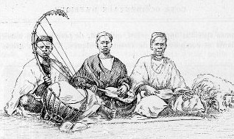
These African story-tellers are responsible for the oral traditions that provide much of the known history of African societies.
Round twelve
Scribes | Sufis
Monks | Griots
Answer: D

Slide 26
What medieval European political system based bonds of loyalty to holdings of land?
Bonus Round twelve
Answer: feudalism

Slide 27
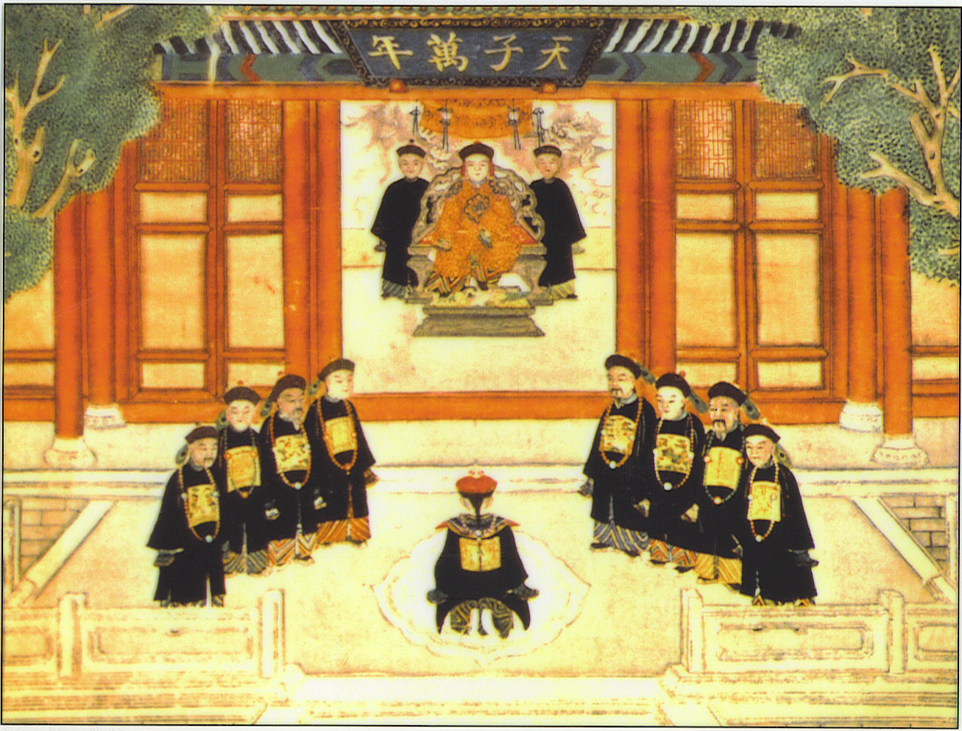
The Chinese dynastic cycle is tied to this concept that establishes a code of behavior for emperors.
Round thirteen
Civil Service Exams | Mandate of Heaven
Pillars of Faith | Eightfold Path
Answer: C

Slide 28
Copied from Persian and Byzantine culture, Islamic tradition says women must do this in public.
Bonus Round thirteen
Answer: wear veils

Slide 29
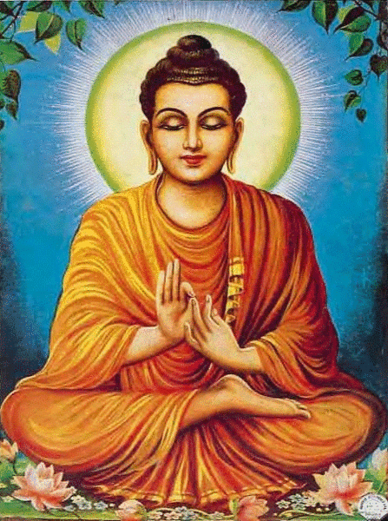
This Brahman prince would become an ascetic and meditate for a month. He became the Buddha.
Round fourteen
Ibn Battuta | Muhammad
Siddhartha Gautama | Laozi
Answer: B

Slide 30
European peasants who worked manors for their lords.
Bonus Round fourteen
Answer: serfs

Slide 31
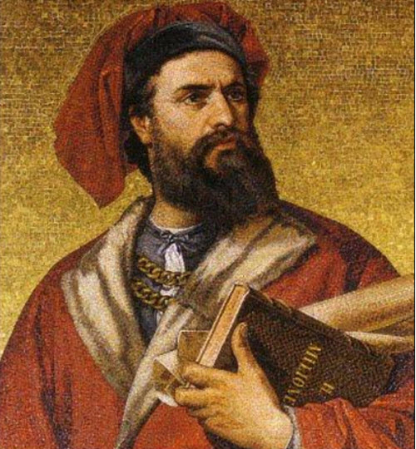
The exploits of Marco Polo sparked European interests in:
Round fifteen
Asian goods. | New World gold.
African slaves. | Greco-Roman writings.
Answer: A

Slide 32
1347-1352 saw 1/3 of Europe’s population wiped out due to:
Bonus Round fifteen
Answer: black death / plague

Slide 33
Rules: Option 1 (Sabotage) – Assassin gets 3 shots; each score removes 1 pt from selected team Option 2 (Gamble) – Team may risk their own pts for up to 3 shots; each risked shot loses 1 pt, but has potential to be worth 3 pts if scored Each team must exercise one of the above options in this round.
Money shot round – part 2

Slide 34
Be sure to study notes from Topics 1.1–1.7 to prepare for the Unit 1 Test.
Thanks for playing!

